Slide 1

Customer Churn Analysis
Uncovering insights into customer behavior and preferences to guide strategic business decisions.

Slide 2


Project Overview
Data Scope
Main Goal
Analyzed 6,400 customer records across various categories.
Uncover insights on churning behavior, customer, and service preferences.
Decision Guidance
Provide data-driven insights to inform strategic business decisions.

Slide 3

Dataset Summary: The Data at a Glance
Overall Shape
Data Content
Rows: 6,418
Customer demographics (Gender, Age, State)
Columns: 32
Subscription attributes (Internet Service, Contract)
A medium-sized customer dataset, easy to manage.
Usage statistics (Monthly Charges, Total Revenue)
Churn fields (Churn Label, Churn Reason)

Slide 4

Key Data Characteristics
Missing Values
Nulls exist but are not extreme; require proper handling before modeling.
Numeric Signals
Tenure, monthly charges, and long-distance charges vary widely, indicating strong churn factors.

Slide 5
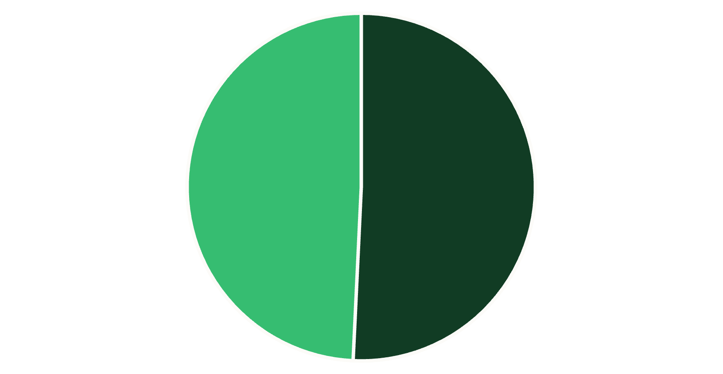

Customer Demographics: Gender & Contract
Customers by Gender
Customers by Contract Type
Month-to-Month
Two Year
One Year
Male
Female

Slide 6
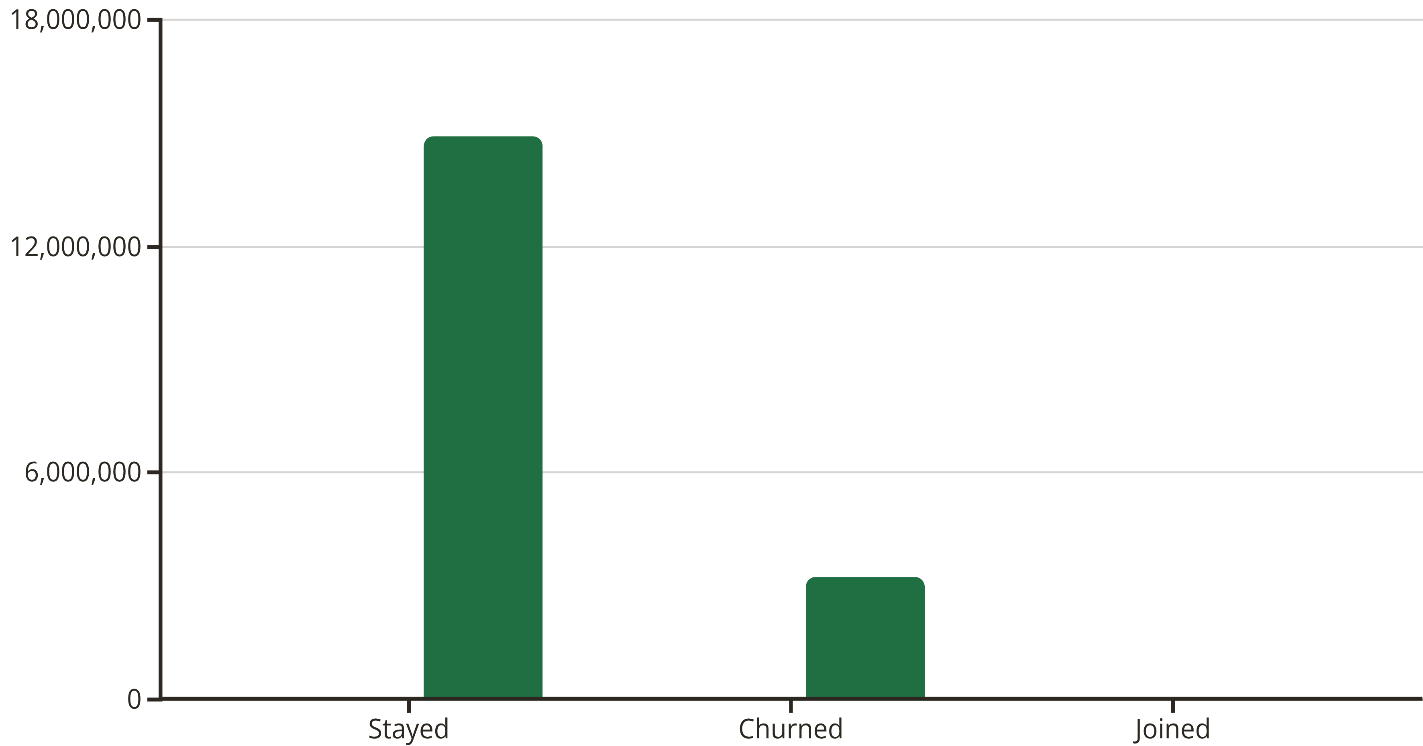
Customer Status & Revenue Contribution
Total Count
Total Revenue
Customers who stayed contribute significantly more revenue than those who churned.

Slide 7

High-Risk Customer Segments
Contract Type
Highest churn rate (46.5%) for Month-to-Month contracts.
Payment Method
Mailed Check (37.8%) and Bank Withdrawal (34.4%) are top churning methods.
Tenure & Age
Shorter tenure (6-24 months) and age group >50 show highest churn rates.
Gender Disparity
Males have significantly higher total churn (64.15%) than females.

Slide 8

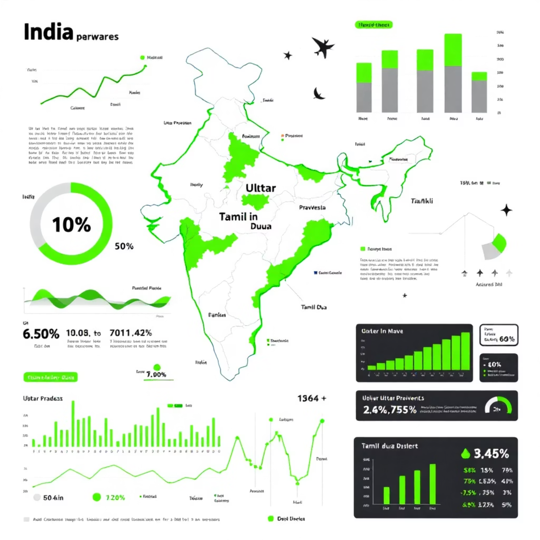
Service & State Performance
Top Churning Service
Geographic Hotspots
Fiber Optic internet accounts for 332 churns.
Uttar Pradesh (157) and Tamil Nadu (153) are major contributors to total churn.

Slide 9



Reason for Churn: Competitor Threat
Competitor
The leading reason for churn (761 instances).
Dissatisfaction
Second highest reason (300 instances).
Competitor influence is more than double the next highest reason, indicating a significant external factor.

Slide 10
Strategic Recommendations
01
02
03
Reduce Month-to-Month Churn
Optimize Payment Processes
Mitigate High-Risk Segments
Incentivize long-term contracts with discounts and perks.
Promote autopay/e-billing and investigate mailed check users.
Target retention campaigns for short-tenure and older customers; tailor male engagement.
04
05
Respond to Competitor Threat
Improve Fiber Optic Service
Conduct competitive analysis and implement a "Save Desk" protocol.
Audit network quality, especially in high-churn states.

